Slide 1
Genomic Data Examination with SparkSQL
Team Members: Tom Bresee, Stephen Johnson, Joe Jiang

Slide 2
Since the completion of the Human Genome Project in 2003, there has been an explosion in data fueled by a dramatic drop in the cost of DNA sequencing, from $3B for the first genome to under $700 today.
Genes carry the information that make you you. When sequenced and stored in a computer, your genome takes up about 150GB of space . . . (and that’s just a single person)
Consequently, the field of genomics has now matured to a stage where companies have started to do DNA sequencing at population-scale. And they are using forms like Apache Spark, SQL, etc to do it (see Databricks announcements on Genomics library developments)

Slide 3
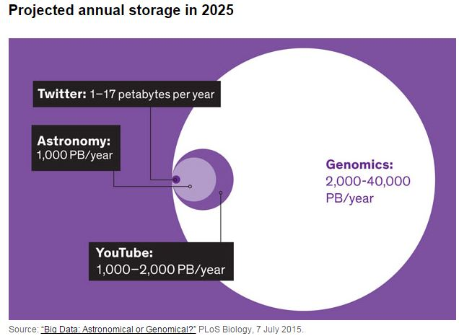
Why this topic ? Because ‘The Genomic Data Explosion’ is real . . .
This is a perfect field for examining
SQL approaches/enhancements at scale

Slide 4
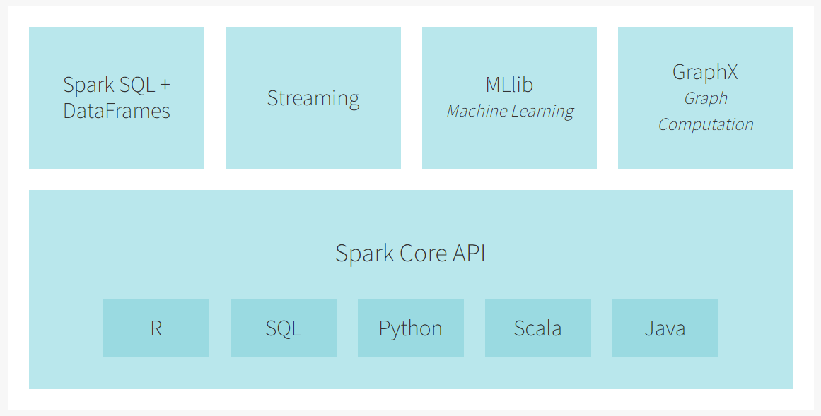
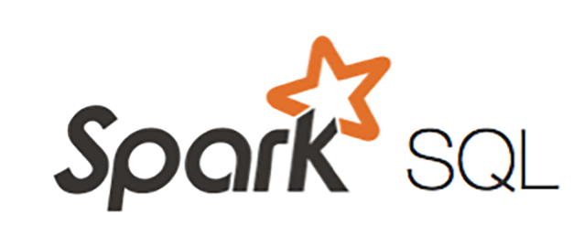
Our Foundation: In Memory Distributed Computing !
= an element contained within our project scope
The Spark Engine
Apache Spark is a unified analytics engine for large-scale data processing.
Notes:
Validate with Sudheer to confirm the data flow
Verify sources – note the big ones, small ones we show others

Slide 5
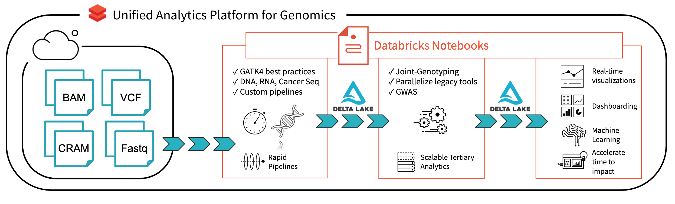
Notes:
Validate with Sudheer to confirm the data flow
Verify sources – note the big ones, small ones we show others

Slide 6
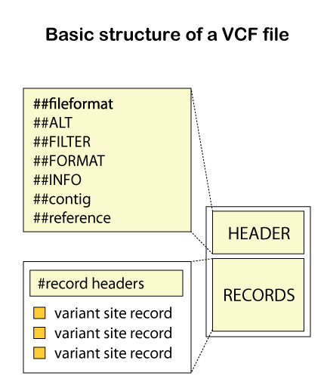
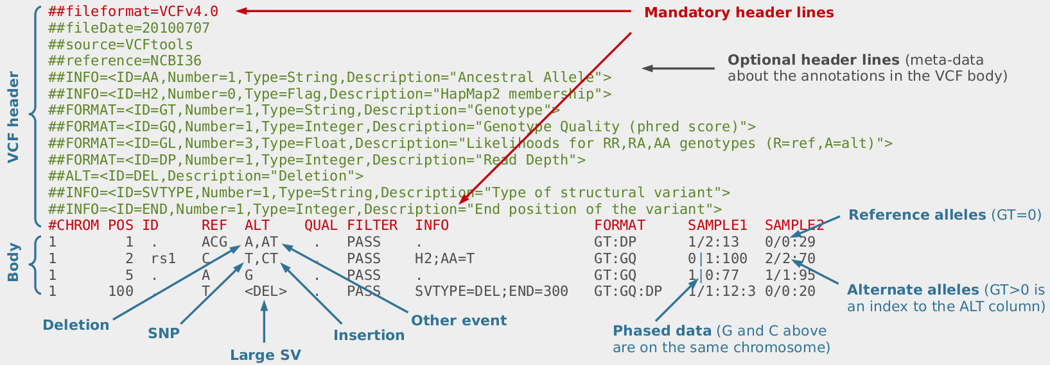
The Types Of Files We Are Looking At Are Complex !
We expect a fair amount of data manipulation and
SQL level filtering to even get our data in the right form !
We are ok with this, it will make us stronger

Slide 7
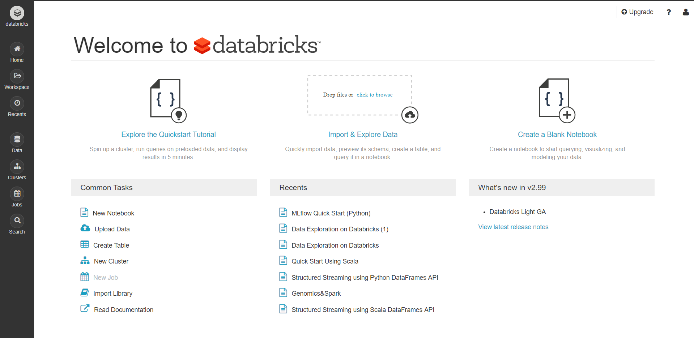
We will be primarily using Databricks (Community Edition)

Slide 8
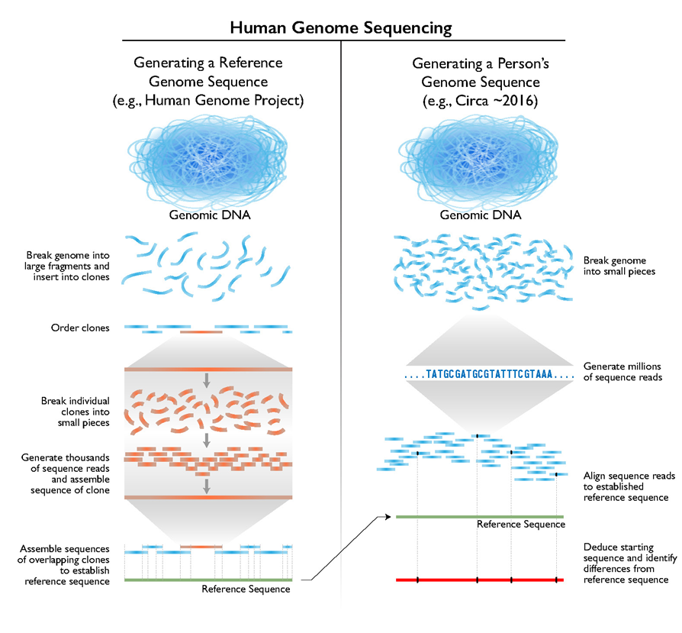
Genomic sequencing mapping on Apache Spark
From NIH

Slide 9
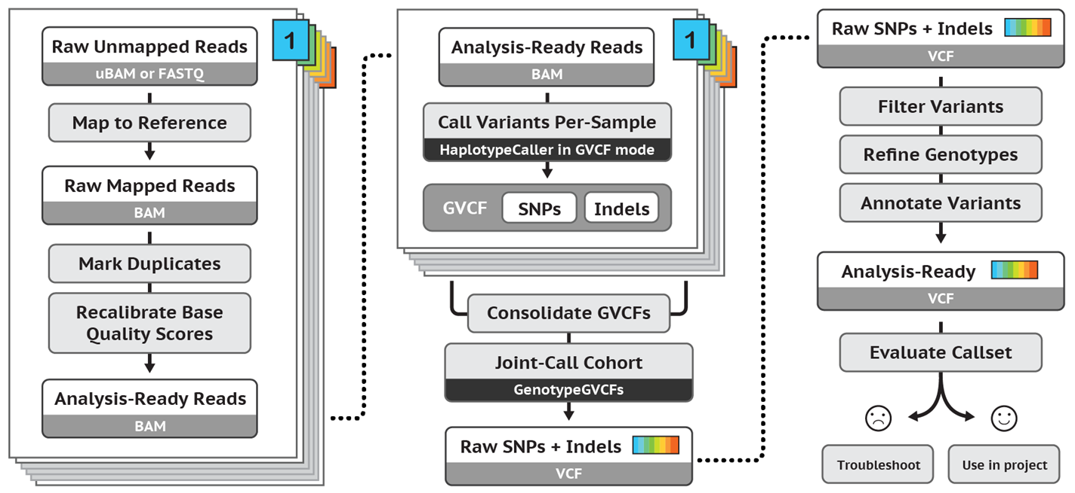
Best Practice for Genomic Sciences
From GATK

Slide 10
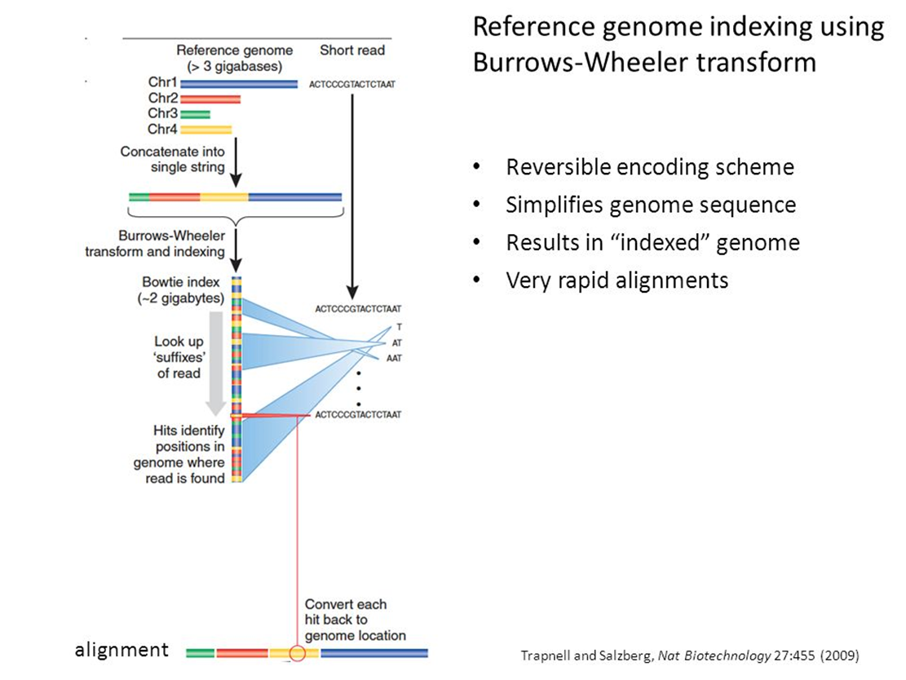
Mapping short reads using BWA
Relevance to database course:
Indexing table (ref genome)
Table Join by Key (mapping)

Slide 11
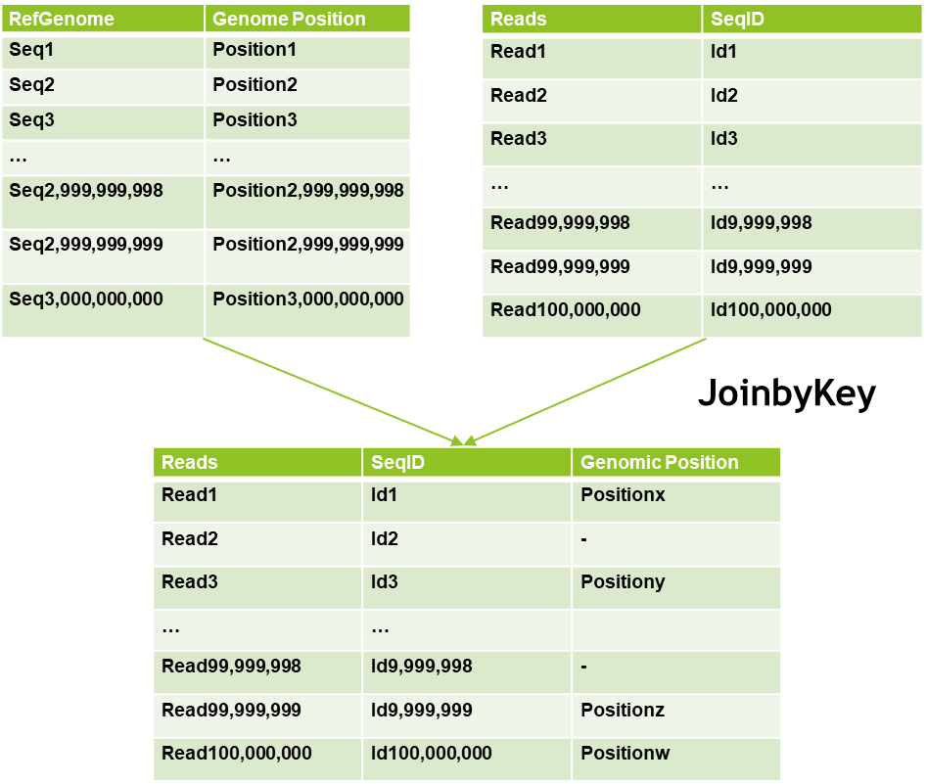
Mapping short reads using BWA (continued)
Read mapping is the bottleneck
Suffer from speed and scale

Slide 12


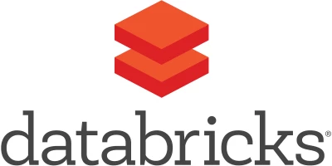

So what precisely are we doing ?
Examining elements such as the run time for Databrick notebooks for genomics processing at scale
Genomic Data Sequencing queries and JOINs
Focusing on analyzing the advantages of
Databricks vs general Apache Spark
Cloud vs non-Cloud KPIs
Benchmarking is big for us !

Slide 13
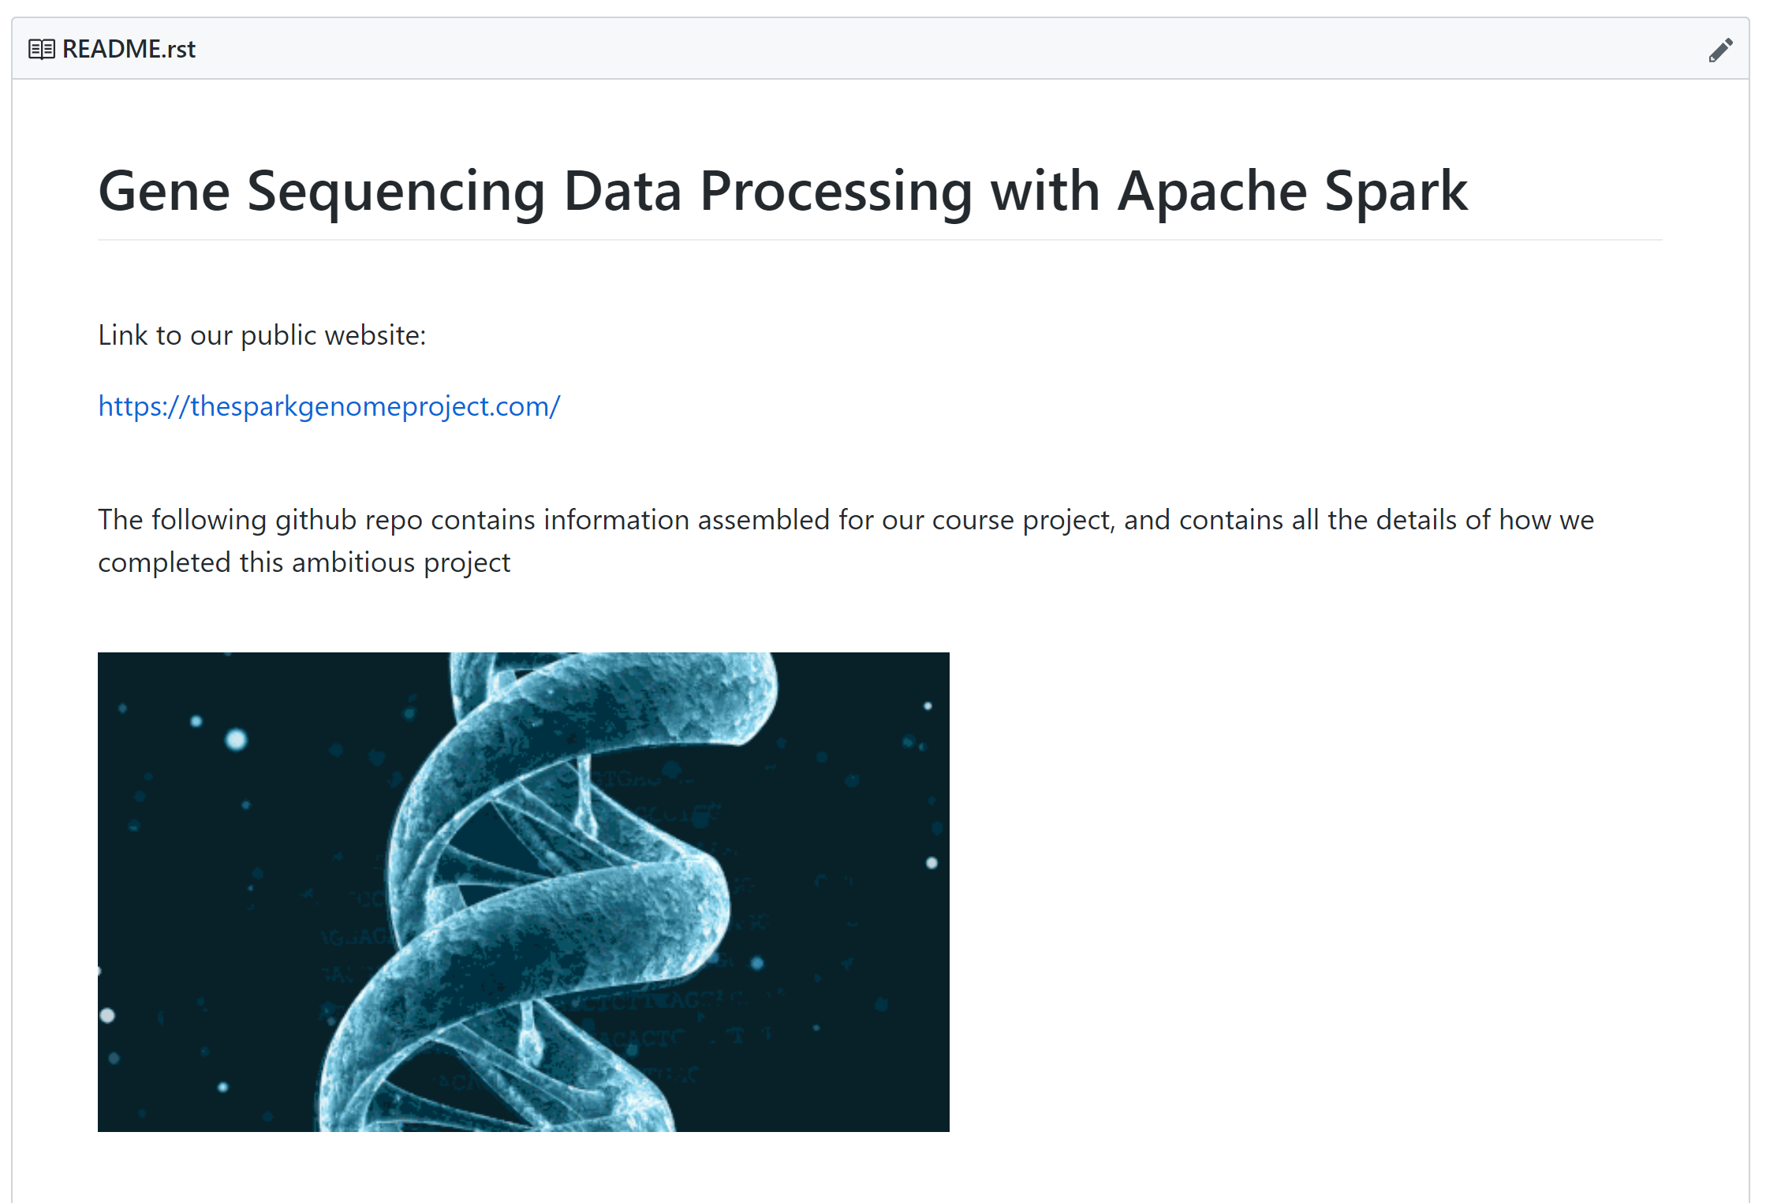
Our Github
https://github.com/TomBresee/The_Spark_Genome_Project
Notes:
Validate with Sudheer to confirm the data flow
Verify sources – note the big ones, small ones we show others

Slide 14
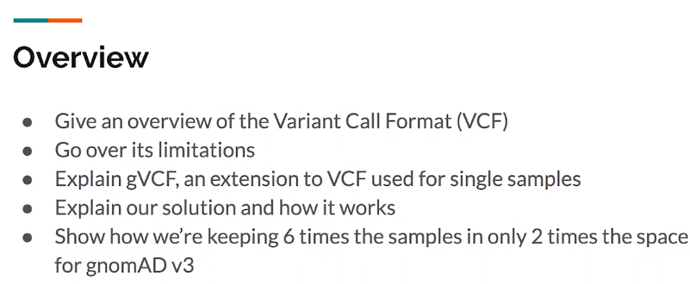
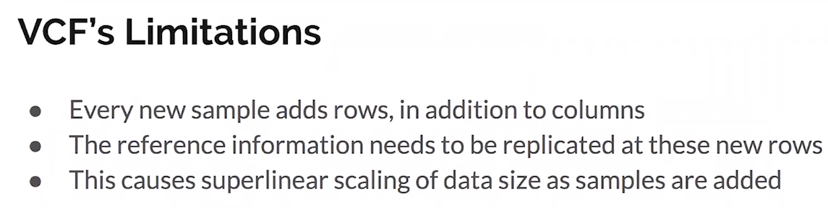
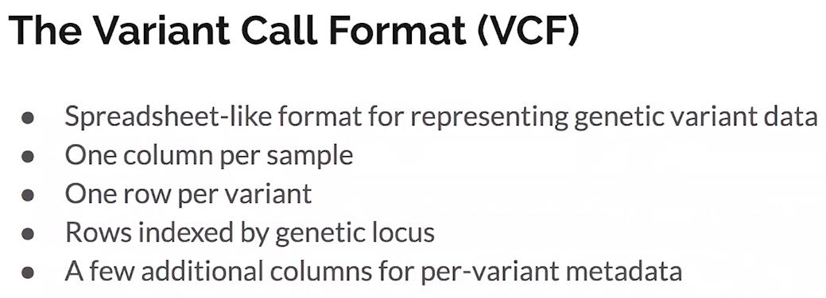
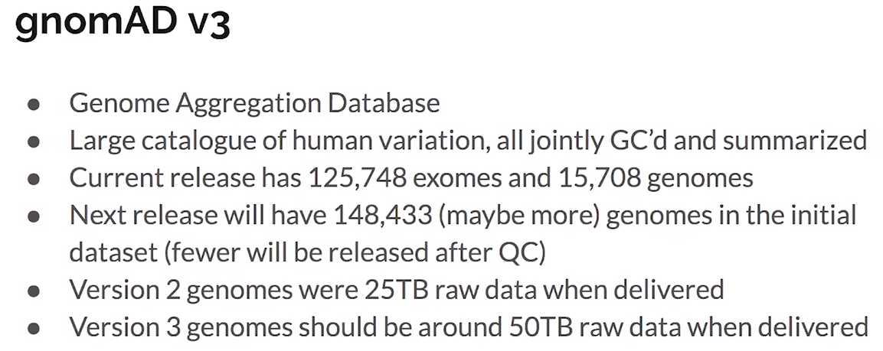
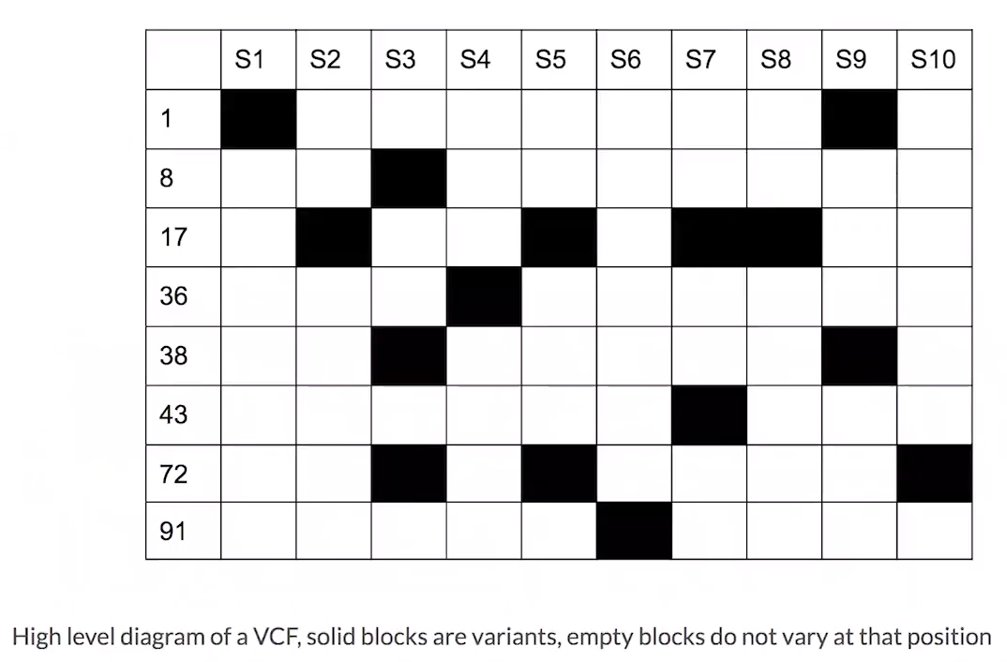
Notes:
Validate with Sudheer to confirm the data flow
Verify sources – note the big ones, small ones we show others

Slide 15
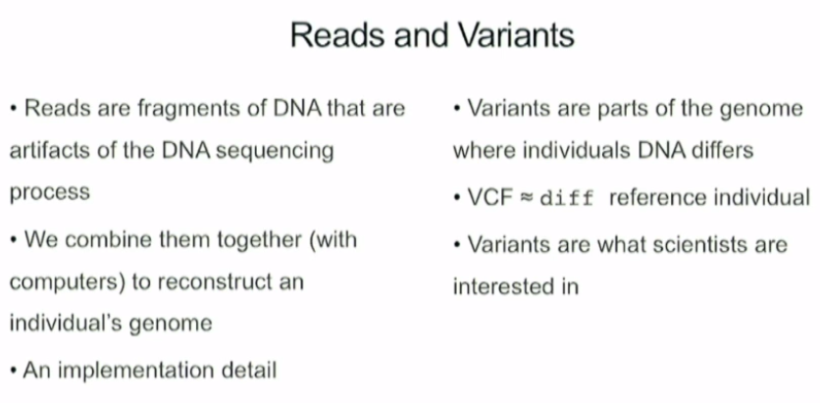
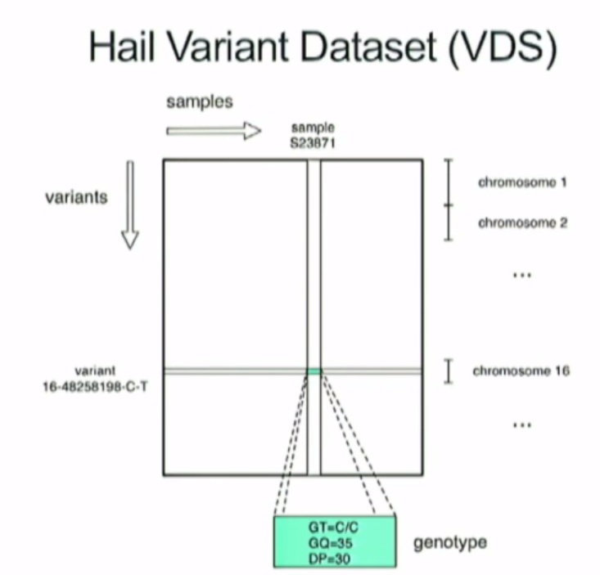
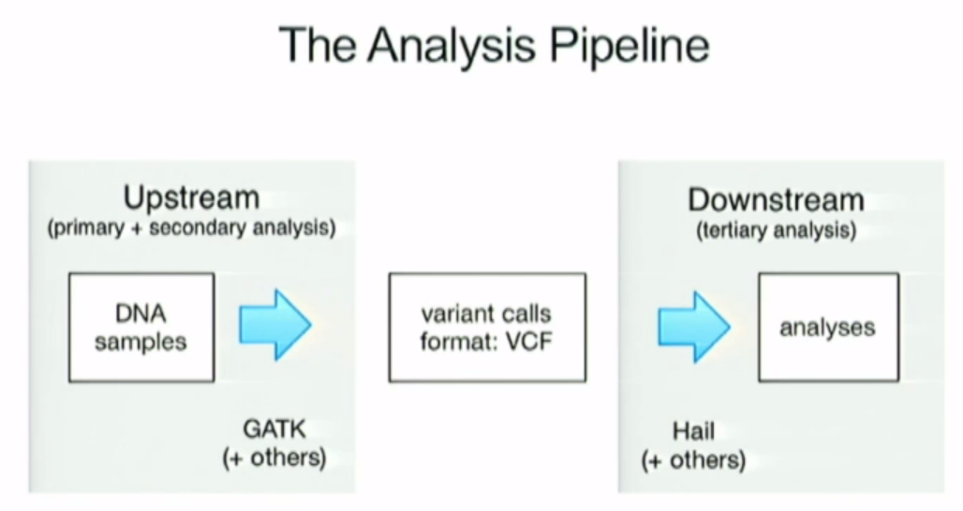
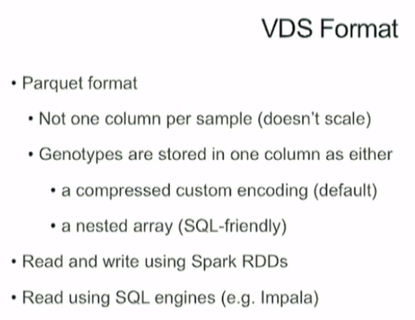
Notes:
Validate with Sudheer to confirm the data flow
Verify sources – note the big ones, small ones we show others

Slide 16
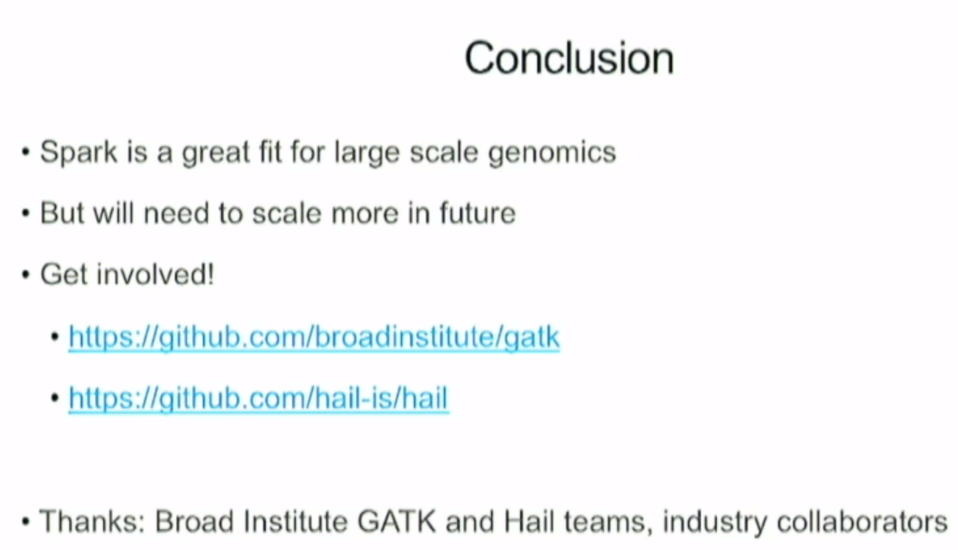
Notes:
Validate with Sudheer to confirm the data flow
Verify sources – note the big ones, small ones we show others

Slide 17
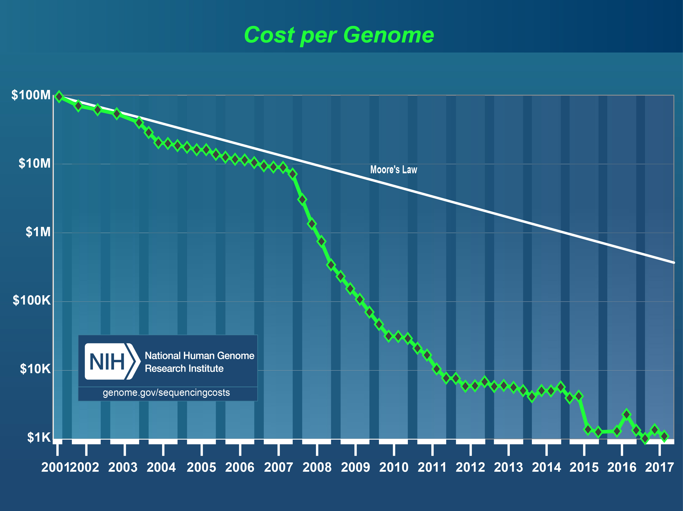
Notes:
Validate with Sudheer to confirm the data flow
Verify sources – note the big ones, small ones we show others

Slide 18
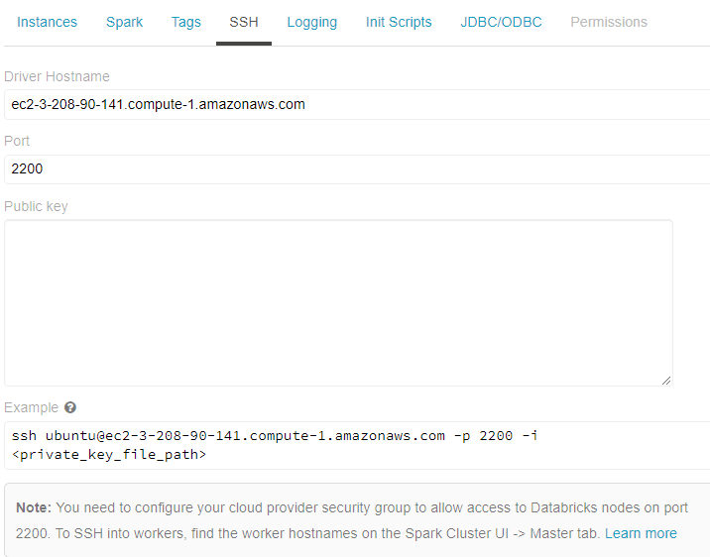
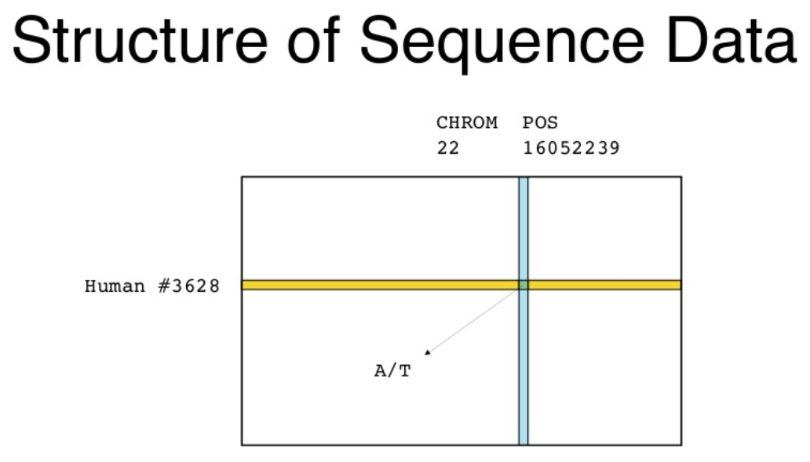
Notes:
Validate with Sudheer to confirm the data flow
Verify sources – note the big ones, small ones we show others

Slide 19
Databricks

Slide 20
